Slide 1
CSS
THE BOX MODEL

Slide 2
Box what?

Slide 3
All boxes

Slide 4
Box types

Slide 5
block

Slide 6
Inline

Slide 7
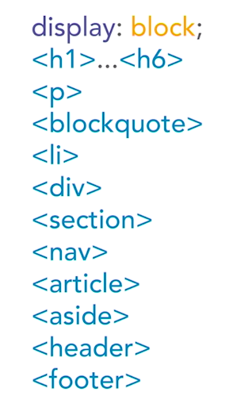
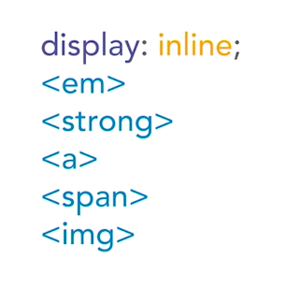
defaults

Slide 8
None

Slide 9
floating

Slide 10
block

Slide 11
Block + 1 float
Not floating
Floating

Slide 12
Block + 2 float
floating
Floating

Slide 13
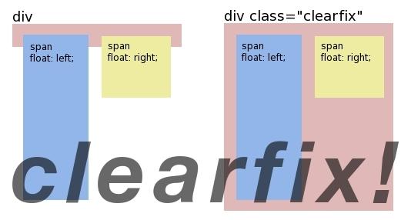

Slide 14
Block + 2 float + clearfix
floating
Floating
<div id=“container”>
<div class=“item1”>floating</div>
<div class=“item2”>floating</div>
<div class=“clearfix”></div>
</div>
Clearfix
.clearfix{
clear: both;
}

Slide 15
Block + 2 float + clearfix
floating
Floating
<div id=“container clearfix”>
<div class=“item1”>floating</div>
<div class=“item2”>floating</div>
</div>
.clearfix{
clear: both;
}

Slide 17
Bye boxes

Slide 18
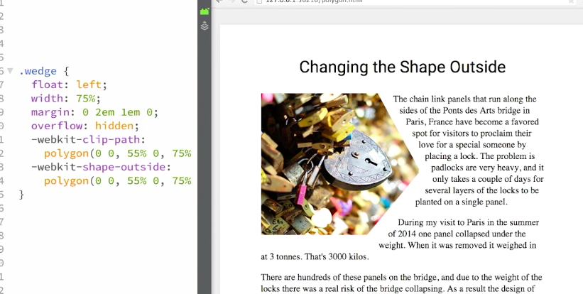

Slide 19
img {
float: left;
width: 150px;
height: 150px;
border-radius: 50%;
}

Slide 20
img {
float: left;
width: 150px;
height: 150px;
border-radius: 50%;
shape-outside: circle();
shape-margin: 15px;
}

Slide 21
FLEX

Slide 22
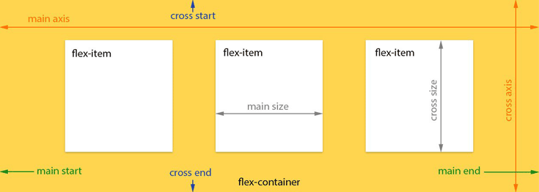

Slide 23
flex-direction
.item {
flex-grow: <number>; /* default 0 */
}
. container{
flex-direction: row | row-reverse | column | column-reverse
}

Slide 24
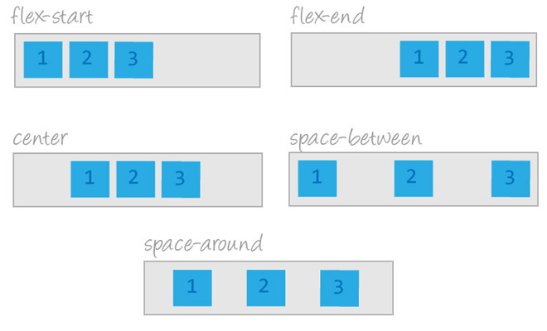
justify-content
. container{
justify-content: <string>
}

Slide 25
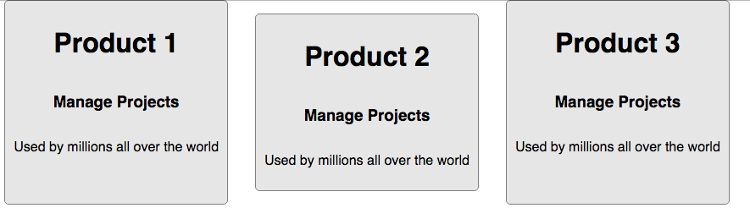
Align-items

Slide 26
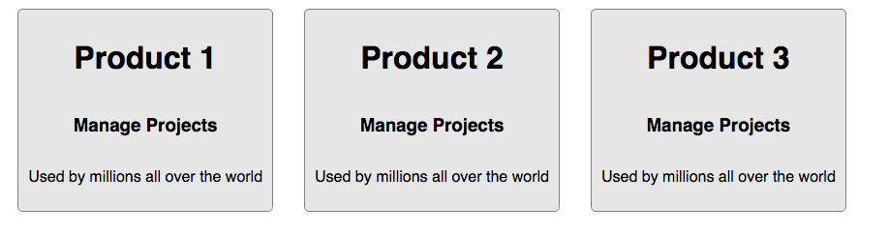
Align-items
.item {
align-items: center;
}

Slide 28
flex-grow
.item {
flex-grow: <number>; /* default 0 */
}

Slide 29
order
.item {
order: <integer>;
}

Slide 30
order
.item {
order: <integer>;
}

Slide 31
Playtime

Slide 32
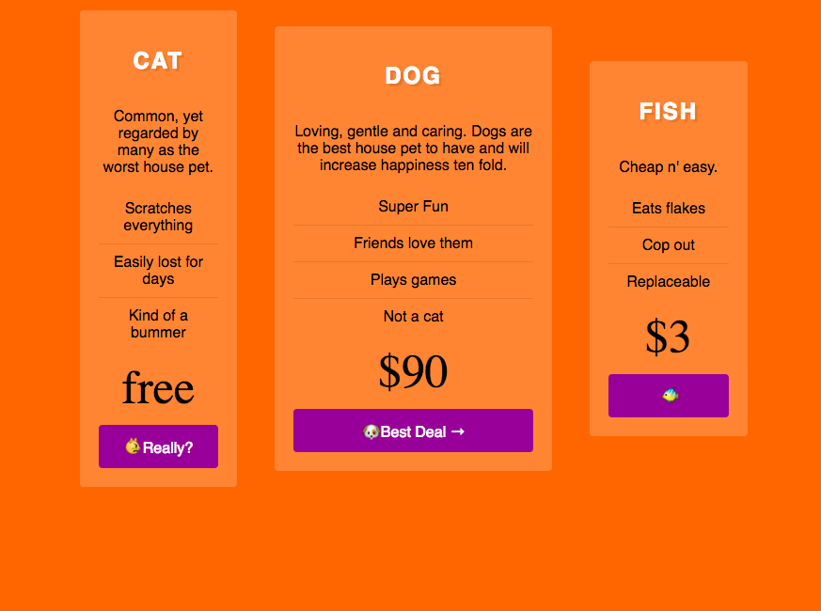

Slide 33
GITHUB
github.com/feelitloveit/cssworkshop

